Slide 1
Bank Loan Classification Analysis
Dream Housing Finance Company
Laila Alshafie, Justin Keith, Rome Palme, Reagan Newswanger, Hannah Steuernagle, Zeejah Waseem

Slide 2
Agenda
Overview
Modeling Techniques Utilized
Data Features
Exploratory Data Analysis & Data Cleaning
Machine Learning Models
Results & Final Solution Advantages
Questions

Slide 3
Dream Housing Finance Company Overview
Business Problem
Dream Housing Finance Company currently manually processes customer eligibility for varying loan amounts.
Business Solution
Automatically identify customers that are eligible for specified loan amounts
Deny loan applications quickly
Reduce hours spent by underwriters reviewing loan applications
Increase precision of loan eligibility identification
Notes:
Business Problem:
Dream Housing Finance Company deals in all kinds of home loans across many different areas such as urban, semi urban, and rural
Currently they are not able to automatically review loans in order to conclude eligibility based on customer online inputs
Business Solution:
After our solution is implemented Dream Housing will be able to automate their loan eligibility process to identify eligible customers for specified loan amounts.
This new solution will also allow the company to immediately deny loan applications or submit them for further review if necessary, reducing hours spent by underwriters in the current state and allowing for precise loan eligibility identification
Pass to Reagan to explain the overall data features

Slide 4
Gender
Education
Dependent
Marital Status
Loan Amount Term
Data Features
Source of Data: Kaggle
Bank_loan Dataset
Self-employed
Applicant / Co-Applicant Income
Credit History
Property Area
Loan Status
Notes:
Target variable loan status

Slide 5
01
Dummy Classifier
Modeling Techniques Utilized
Source of Data: Kaggle
02
Decision Tree
Modeling Techniques
03
Random Forest
04
XG Boost Classifier

Slide 6
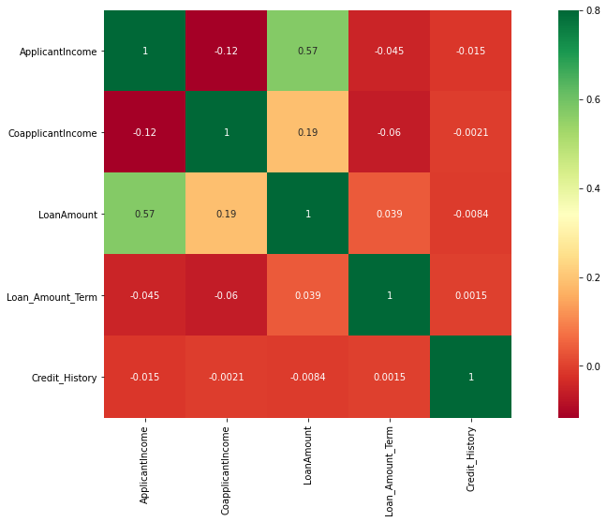
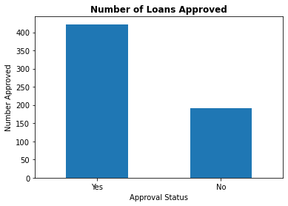
EDA and Data Cleaning
Notes:
Transition on data cleaning topic

Slide 7

Machine Learning Models Iterations

Slide 8




Initial Modeling Approaches
Dummy Classifier
Initial examination of features regarding loan approval
Decision Tree Classifier
Precision increases by 12% to display the best automated approval rate
Random Classifier
Precision increases by 0.8% to display and even better automated approval rate

Slide 9
Best Machine Learning Model: XG Boost Classifier

Slide 10
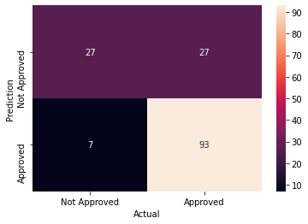
Our model minimizes the number of cases where loans have been approved that should have been rejected
True Negative
False Negative
False Positive
True Positive

Slide 11
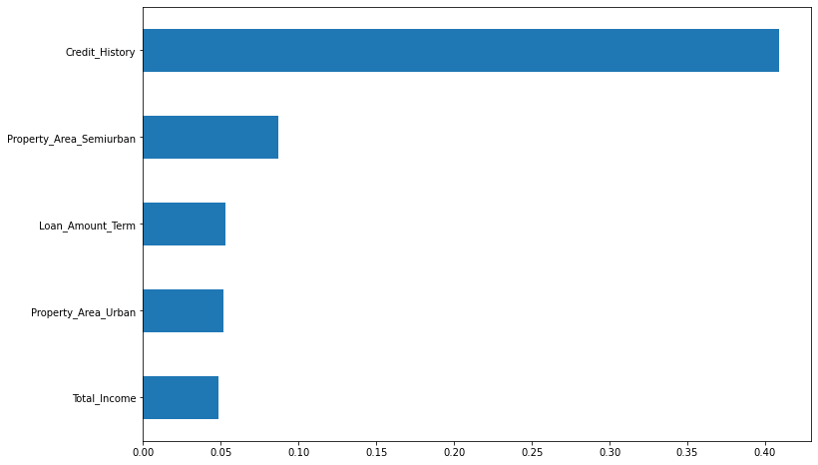
Results – Heavily Impacted Loan Features
Notes:
Our analysis identified the following top five features that heavily impact loan eligibility:
These features, once visualized, provide a clear understanding of the factors that drive loan approval decisions. Understanding these key elements enables the company to focus its attention on the most impactful aspects of a customer's profile.

Slide 12
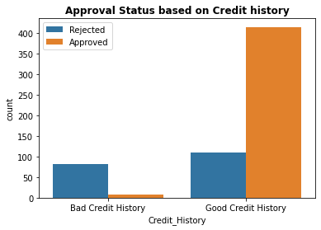
Deeper Dive Into Results
Notes:
Credit History Impact:
Our analysis indicates a significant correlation between credit history and loan approval. Customers with a good credit history are more likely to receive approval, whereas those with a bad credit history face higher rejection rates. To quantify this, we can present the same information as a percentage, offering a clearer understanding of the impact of credit history on loan approval rates.
Property Area Influence
Geographic location plays a role in loan approval, with semi-urban areas showing a higher likelihood of success. On the other hand, customers in rural areas are more likely to face rejection. This insight can guide the company's marketing and targeting strategies, ensuring a more precise approach to potential clients based on their property area.
Loan Amount Term Analysis:
Loan amount terms, specifically the standard term of 360 months, exhibit the highest likelihood of approval. Understanding the preferred loan terms of approved applicants allows the company to align its offerings with customer preferences, potentially increasing approval rates.

Slide 13
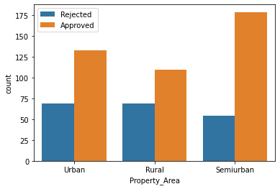
Deeper Dive Into Results
Approval Status based on Property Area
Notes:
Credit History Impact:
Our analysis indicates a significant correlation between credit history and loan approval. Customers with a good credit history are more likely to receive approval, whereas those with a bad credit history face higher rejection rates. To quantify this, we can present the same information as a percentage, offering a clearer understanding of the impact of credit history on loan approval rates.
Property Area Influence
Geographic location plays a role in loan approval, with semi-urban areas showing a higher likelihood of success. On the other hand, customers in rural areas are more likely to face rejection. This insight can guide the company's marketing and targeting strategies, ensuring a more precise approach to potential clients based on their property area.
Loan Amount Term Analysis:
Loan amount terms, specifically the standard term of 360 months, exhibit the highest likelihood of approval. Understanding the preferred loan terms of approved applicants allows the company to align its offerings with customer preferences, potentially increasing approval rates.

Slide 14
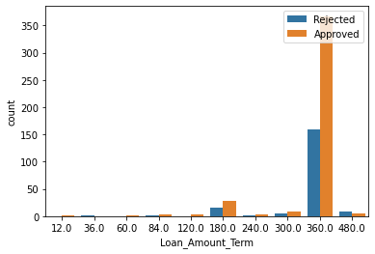
Deeper Dive Into Results
Approval Status based on Loan Amount Term
Notes:
Credit History Impact:
Our analysis indicates a significant correlation between credit history and loan approval. Customers with a good credit history are more likely to receive approval, whereas those with a bad credit history face higher rejection rates. To quantify this, we can present the same information as a percentage, offering a clearer understanding of the impact of credit history on loan approval rates.
Property Area Influence
Geographic location plays a role in loan approval, with semi-urban areas showing a higher likelihood of success. On the other hand, customers in rural areas are more likely to face rejection. This insight can guide the company's marketing and targeting strategies, ensuring a more precise approach to potential clients based on their property area.
Loan Amount Term Analysis:
Loan amount terms, specifically the standard term of 360 months, exhibit the highest likelihood of approval. Understanding the preferred loan terms of approved applicants allows the company to align its offerings with customer preferences, potentially increasing approval rates.

Slide 15
Final Solution Advantages
Reduces Hours Spent by Underwriters Reviewing Loan Applications
Automatically Identify Customers Eligible for Loans with Precision
Instantly Deny Loan Applications or Submit for Further Review
Notes:
In conclusion, our analysis not only streamlines the loan approval process but also provides actionable recommendations to enhance Dream Housing Finance Company's operations. By leveraging these insights, the company can significantly improve its precision in identifying eligible customers, reduce processing times, and strategically position itself in the competitive loan market.

Slide 16

Thank You!
Any Questions?

